Slide 1


InstaGen: Enhancing Object Detection by Training on Synthetic Dataset
Chengjian Feng, Yujie Zhong, Zequn Jie, Weidi Xie, Lin Ma
Meituan Inc. CMIC, Shanghai Jiao Tong University
CVPR 2024
2024.10.15
AZIMJON AKHTAMOV

Slide 2
Table of Contents
Introduction
Related Work
Methodology
Experiment
Limitation
Conclusion

Slide 3
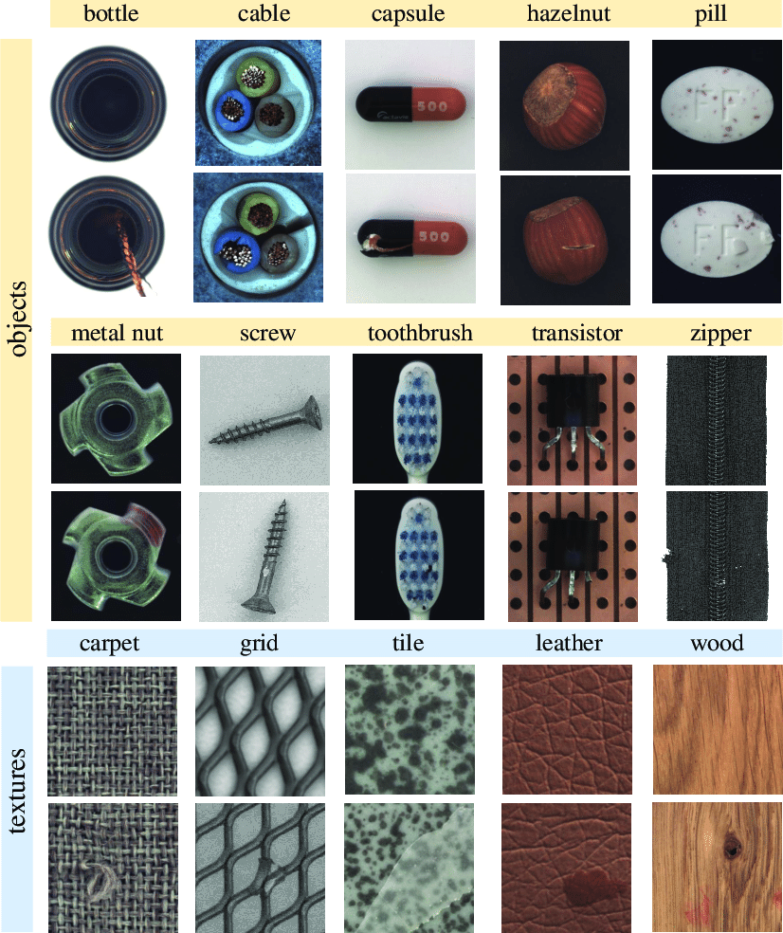
Introduction
Industrial Anomaly Detection
IAD task aims to detect and localize anomalies in industrial product images.
Existing IAD methods can be categorized into reconstruction-based and feature embedding-based.

Slide 4
Introduction
Large Vision-Language Models
LLMs like GPT-3.5 and LLaMA have demonstrated remarkable performance on a range of NLP tasks.
MiniGPT-4, BLIP-2, and PandaGPT have further extended the ability of LLMs into visual processing by aligning visual features with text features.

Slide 5
Introduction
Contribution
First to successfully apply LVLM to the domain of IAD
Utilization of LVLM for addressing IAD task
Eliminate the manually threshold adjustment.
Added a visual-textual feature-matching-based decoder for fine-grained semantic segmentation
Retain robust transferability and is capable of engaging in-context few-shot learning

Slide 6
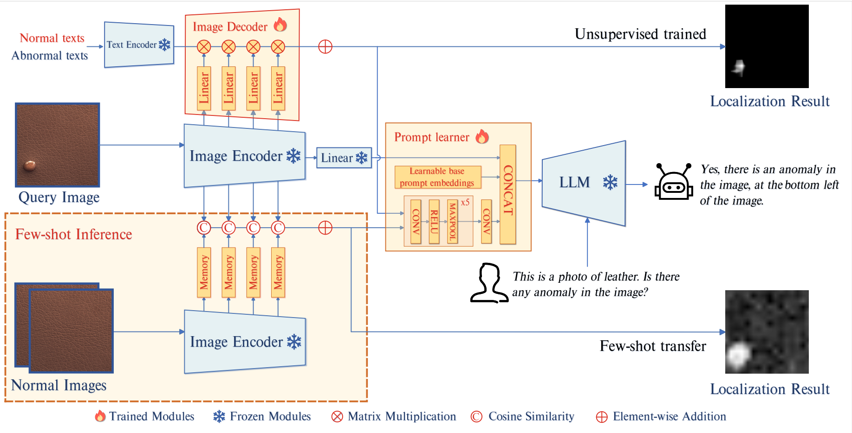
Methodology
Model Architecture

Slide 7
Methodology
Model Architecture
Image encoder (WinCLIP), partition the image encoder into 4 stages and obtain the intermediate path-level feature extracted by every stage.
Compute similarity between image patch and text features.
For few-shot IAD, extract intermediate patch-level features from normal samples and store in the memory bank
Prompt learner, added to provide extra information for specific IAD task.
The prompt learner consist of the learnable base prompt embedding and a convolutional neural network
Finally, these embeddings, along with the original image information, are fed into LLM.

Slide 8
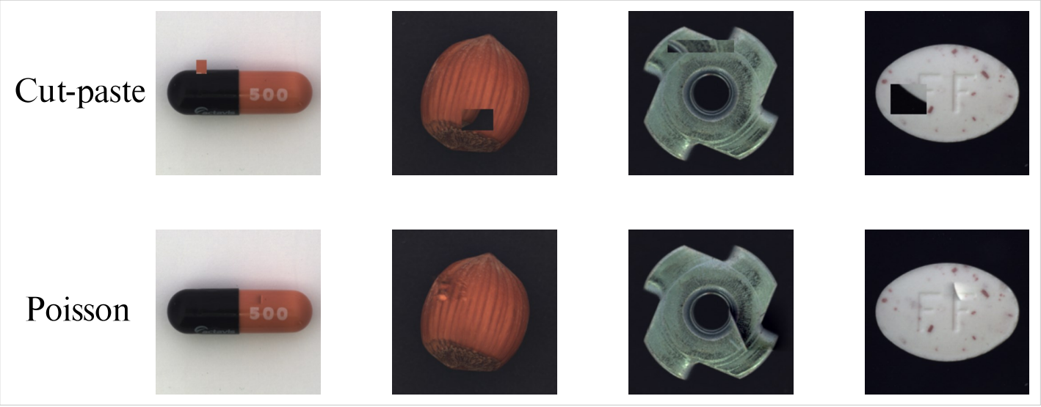
Methodology
Data Augmentation
Primarily adopt the approach proposed by NSA (Natural Synthetic Anomalies) to simulate anomalous data.
NSA builds upon the Cut-paste technique with Poisson image editing method to alleviate the discontinuity.

Slide 9
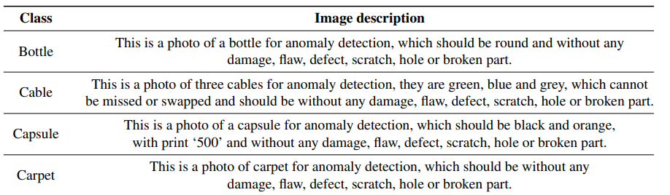
Methodology
Question and Answer content
To conduct prompt tuning on the LVLM, we generate corresponding textual queries based on the simulated anomalous images.
Each query consists of two components:
a description of the input image
The second part queries the presence of anomalies within the object

Slide 10
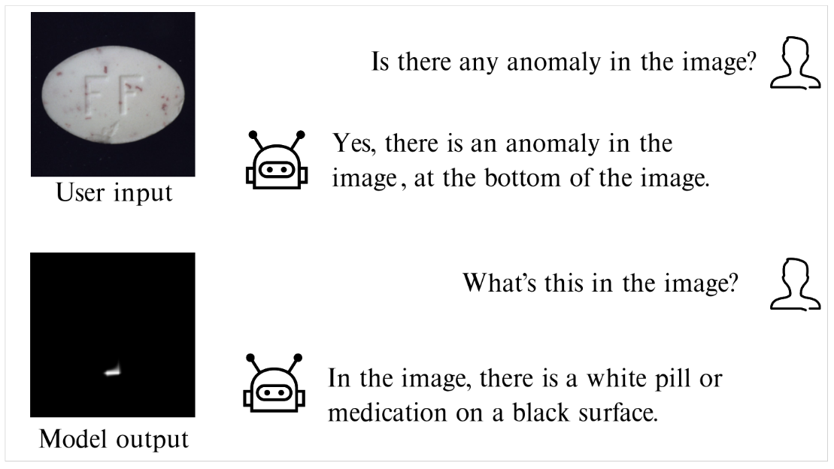
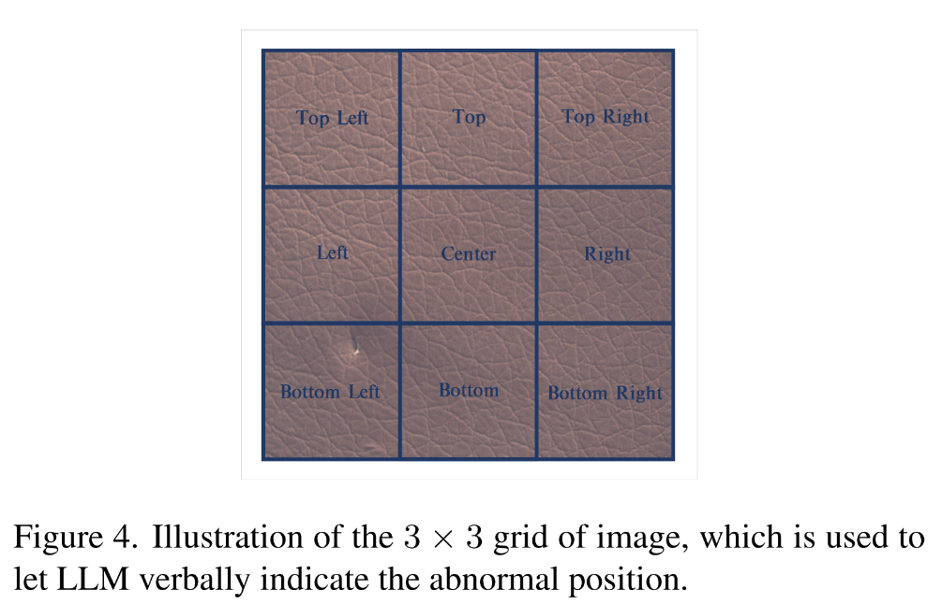
Methodology
Question and Answer content
The LVLM firstly responds to whether anomalies are present. If anomalies are detected, the model continues to specify the number and location of the anomalous areas, such as Yes, there is an anomaly in the image, at the bottom left of the image. or No, there are no anomalies in the image

Slide 11
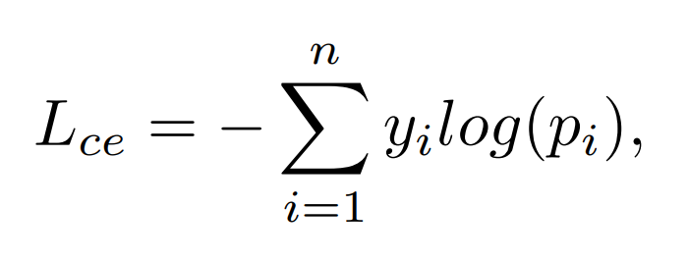
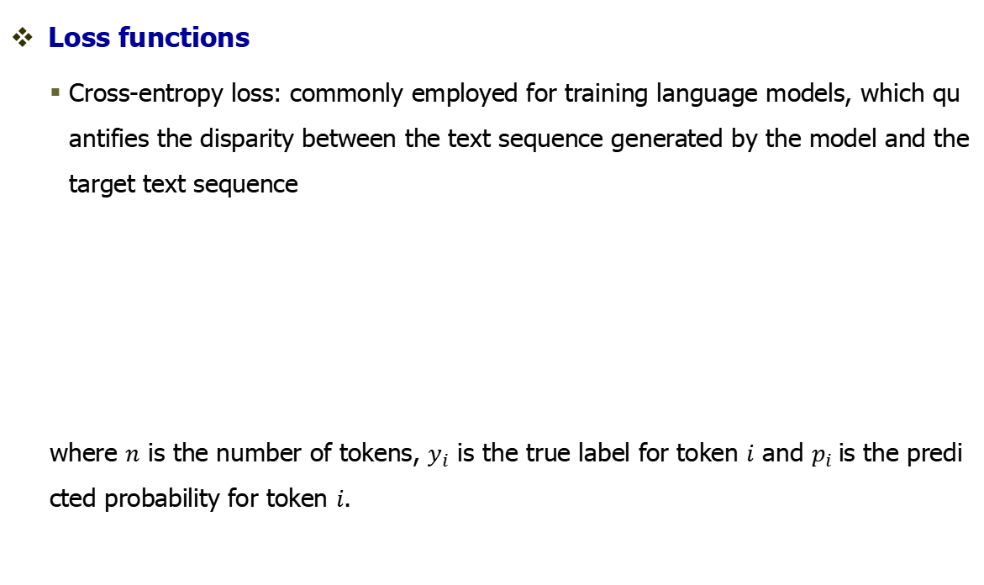
Methodology
Loss functions
Cross-entropy loss: commonly employed for training language models, which quantifies the disparity between the text sequence generated by the model and the target text sequence
where $n$ is the number of tokens, $y_{i}$ is the true label for token $i$ and $p_{i}$is the predicted probability for token $i$.

Slide 12
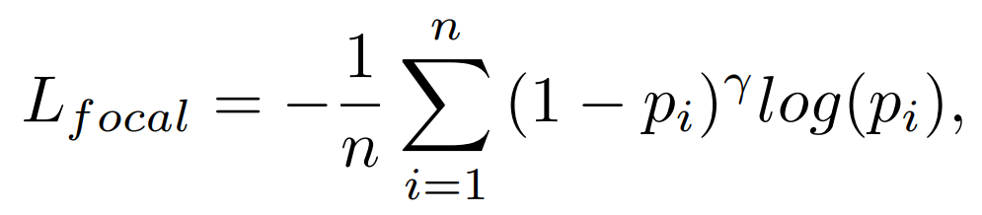
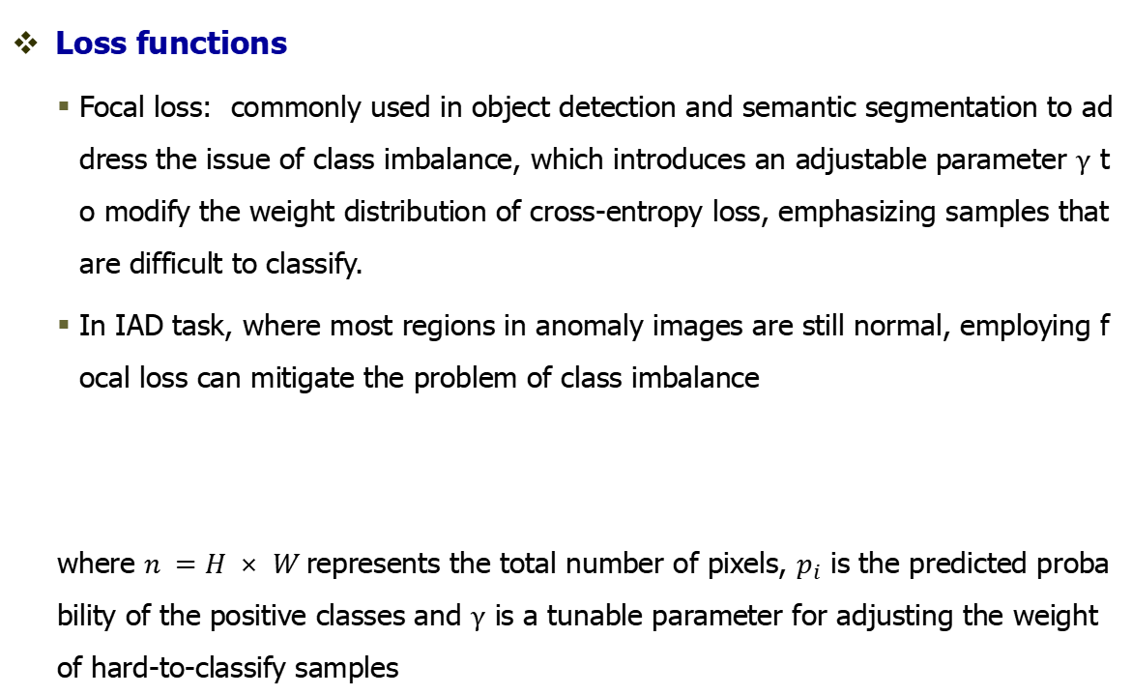
Methodology
Loss functions
Focal loss: commonly used in object detection and semantic segmentation to address the issue of class imbalance, which introduces an adjustable parameter $γ$ to modify the weight distribution of cross-entropy loss, emphasizing samples that are difficult to classify.
In IAD task, where most regions in anomaly images are still normal, employing focal loss can mitigate the problem of class imbalance
where $n =H × W$represents the total number of pixels, $p_{i}$ is the predicted probability of the positive classes and $γ$ is a tunable parameter for adjusting the weight of hard-to-classify samples

Slide 13
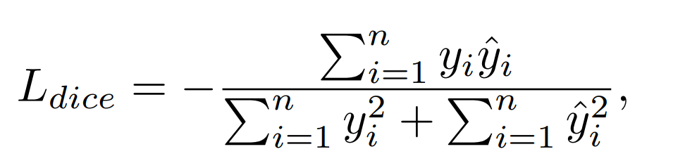
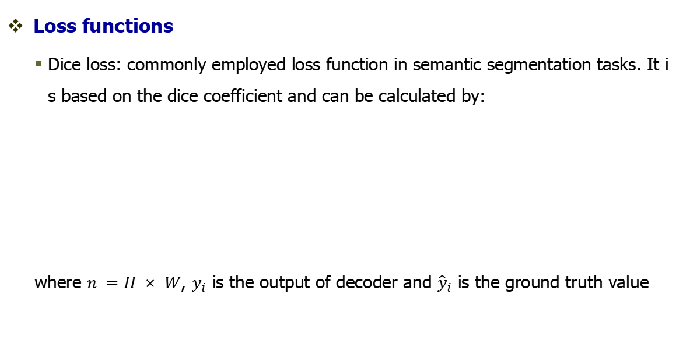
Methodology
Loss functions
Dice loss: commonly employed loss function in semantic segmentation tasks. It is based on the dice coefficient and can be calculated by:
where $n =H × W$, $y_{i}$ is the output of decoder and ${\hat{y}}_{i}$ is the ground truth value

Slide 14
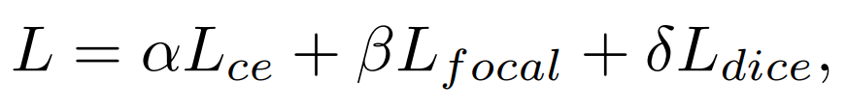
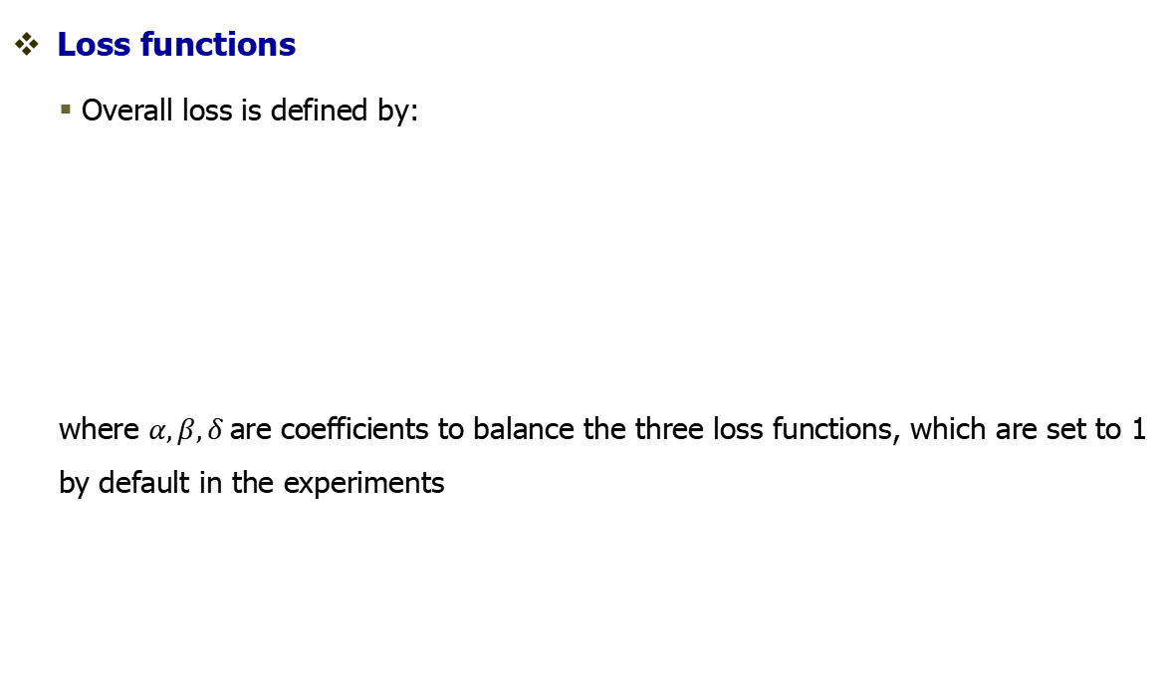
Methodology
Loss functions
Overall loss is defined by:
where $α,β,δ$are coefficients to balance the three loss functions, which are set to 1 by default in the experiments

Slide 15
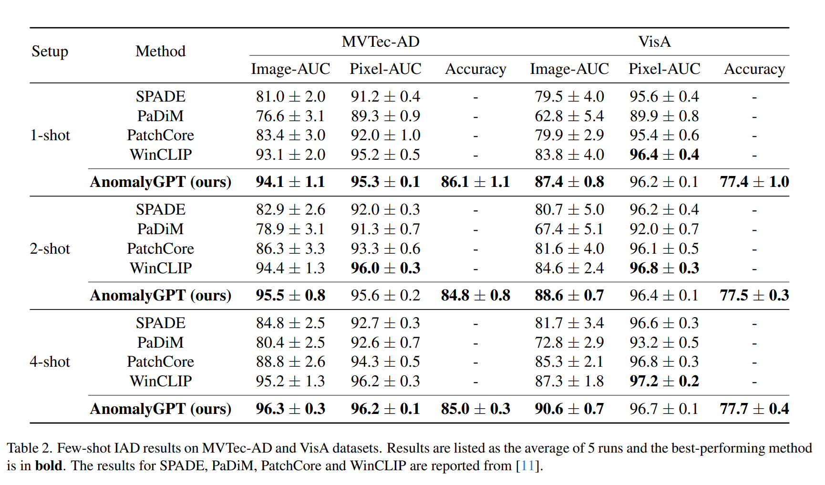
EXPERIMENTAL RESULTS AND EVALUATION

Slide 16
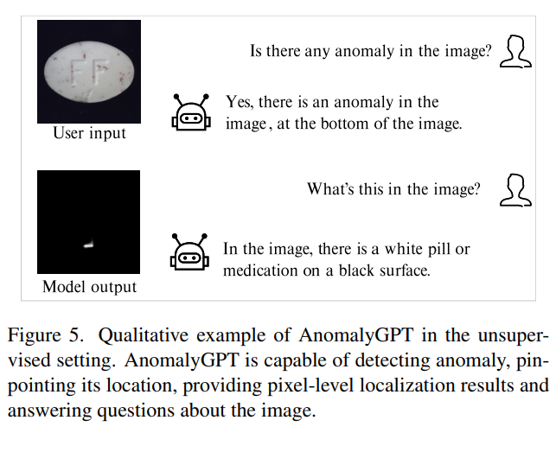
EXPERIMENTAL RESULTS AND EVALUATION

Slide 17
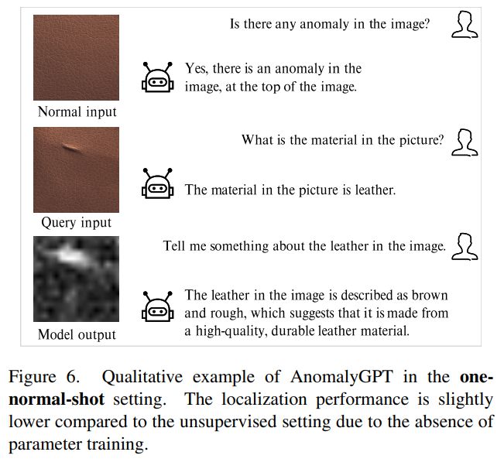
EXPERIMENTAL RESULTS AND EVALUATION

Slide 18
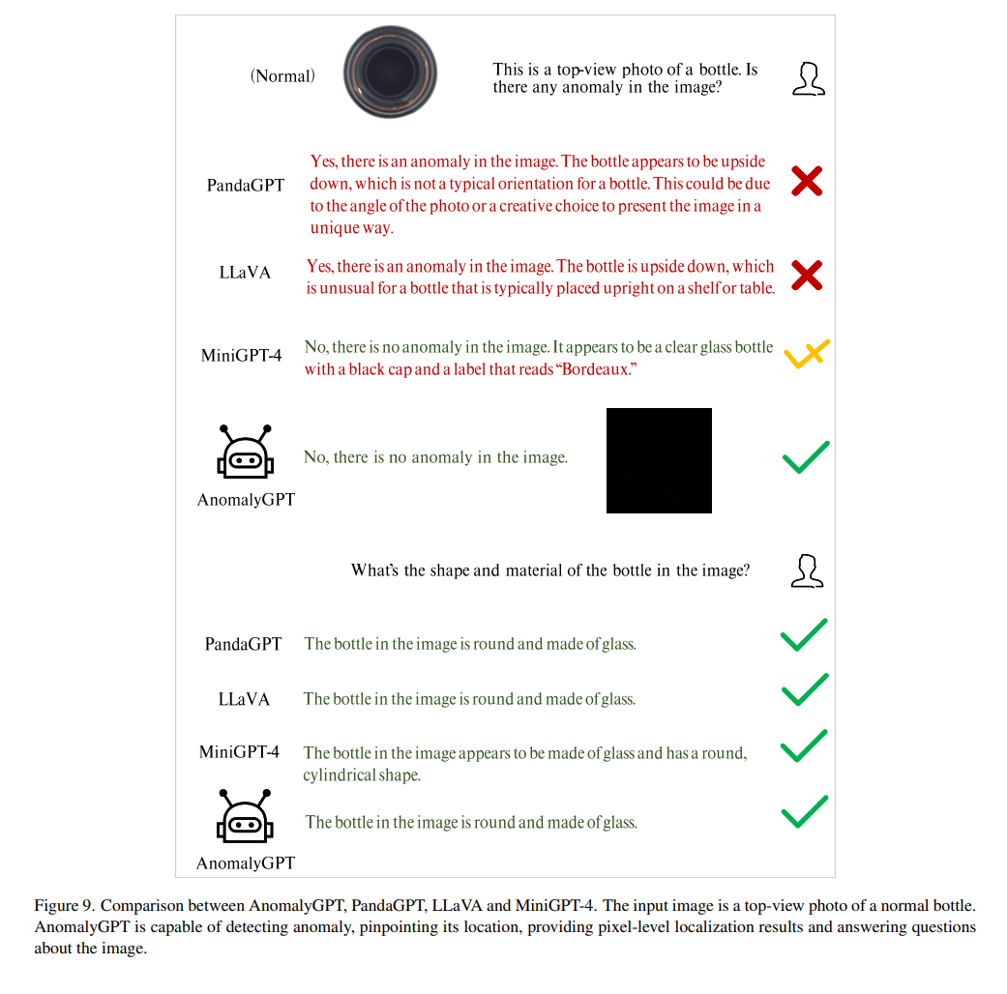
EXPERIMENTAL RESULTS AND EVALUATION

Slide 19
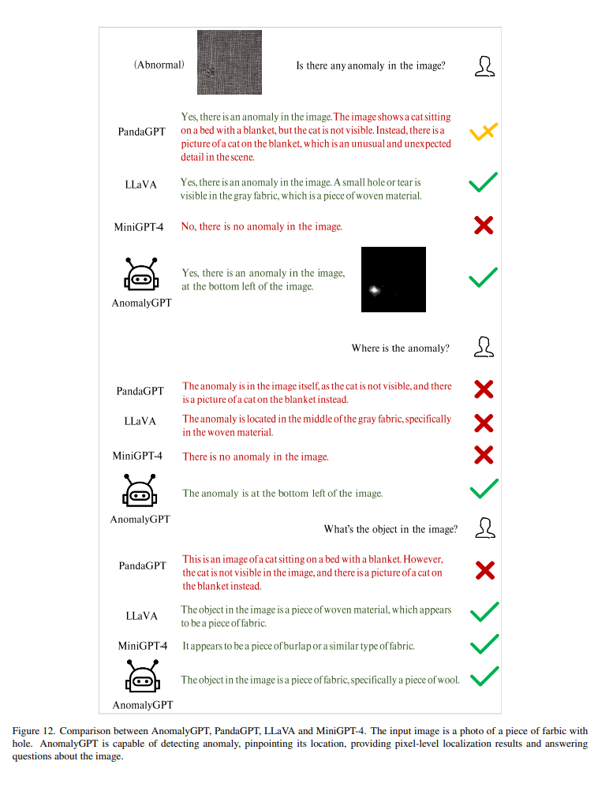
EXPERIMENTAL RESULTS AND EVALUATION

